Slide 1
Panorama Image Stitching
Jonathan Kelaty

Slide 2
Problem
We want to create a panorama by stitching together a series of images showing a continuous scene.
Result should be continuous and (ideally) without a seam, although differences in lighting conditions from image to image can result in a seam where images are stitched together in the final result.
How do we find the overlapping regions and produce the stitched together panorama?
Notes:
How presentation will benefit audience: Adult learners are more interested in a subject if they know how or why it is important to them.
Presenter’s level of expertise in the subject: Briefly state your credentials in this area, or explain why participants should listen to you.

Slide 3
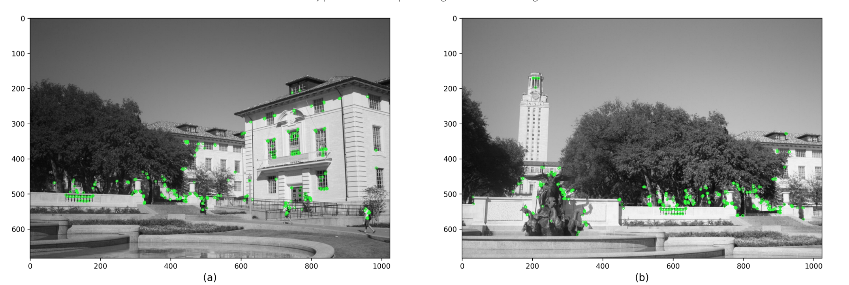
How to accomplish?
1. Extract features and keypoints from each image using using feature detector algorithm - SIFT (Scale-invariant feature transform): Good, but patented.. 👎 - SURF (Speeded up robust features): Faster, but still patented 👎 - ORB (Oriented FAST and rotated BRIEF): Even faster, and free! 👍

Slide 4
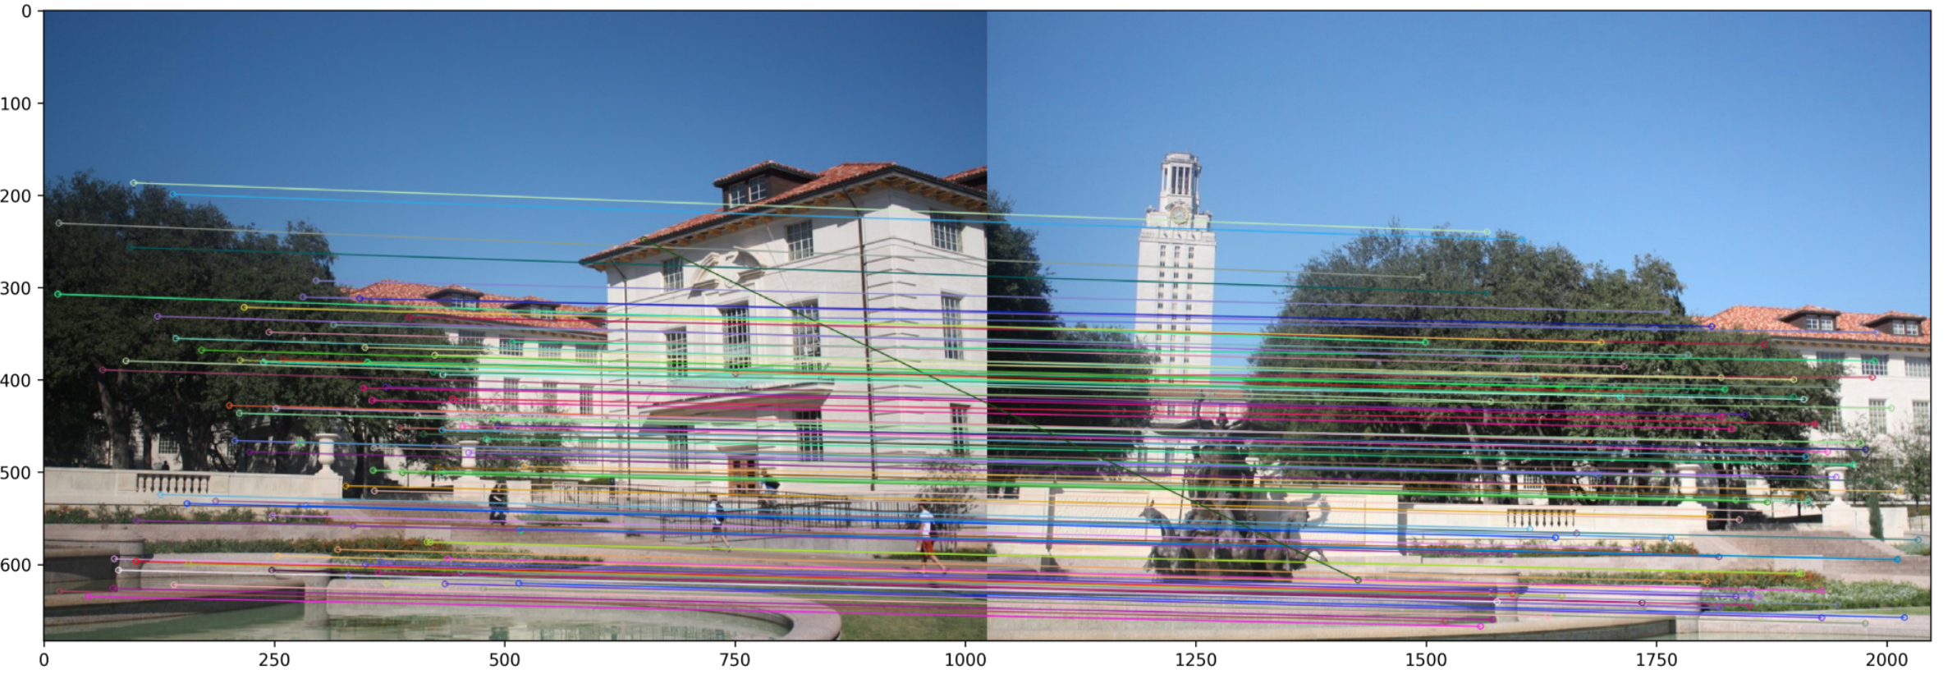
How to accomplish?
2. Use feature matching algorithm to find best matching features between images. kNN can be used to accomplish this using features found from the previous step.

Slide 5
How to accomplish?
3. Homography estimation using RANSAC
Finds the model which describes the rotation/translation of the camera between two images
4. Warp image perspectives and blend result into final panorama using computed homography matrix

Slide 6
Project Status
Original plan was to create iOS app, build clean interface to create panorama images. OpenCV linking error in Xcode prevented progress
Command line/GUI desktop interface in C++
CLI that accepts arguments to create panoramas. Supplemented by GUI for selecting images, previewing panorama, and saving results + additional features
Accepts a list of images, a video file, or webcam as input
OpenCV still used for image processing
Built in demos of image datasets ranging from 2 - 50+ images per set

Slide 7
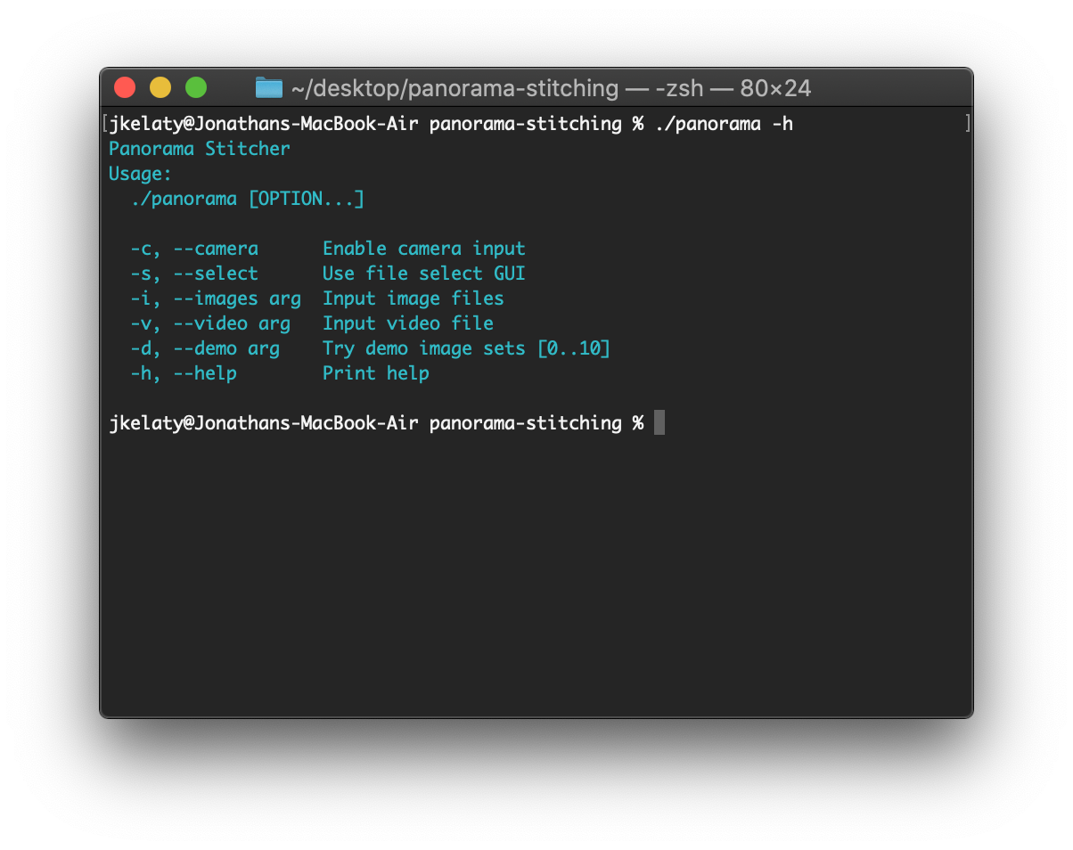
Project Status
Sample of program interface:
See full program implementation details on GitHub

Slide 8
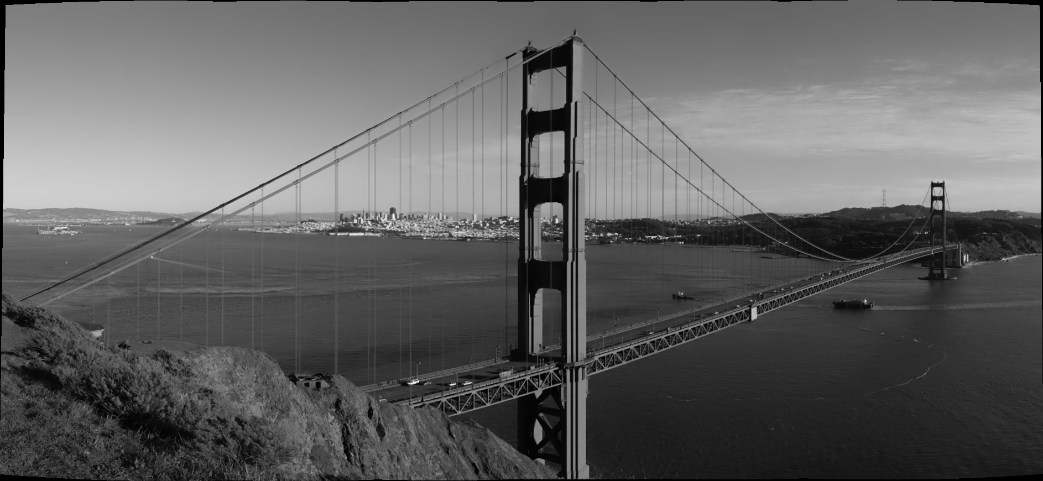
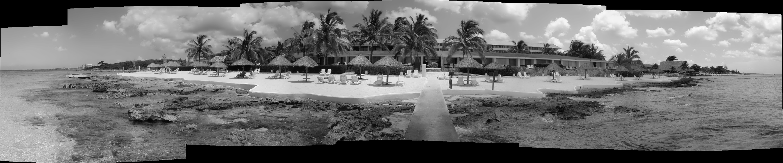
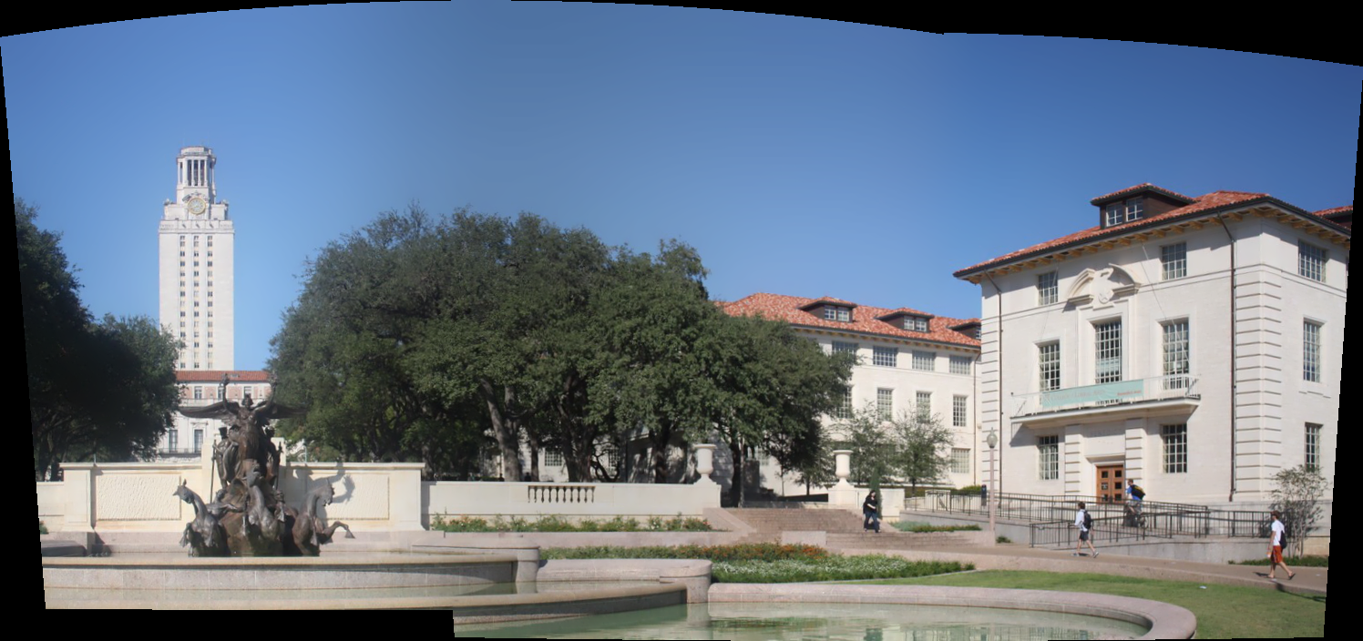
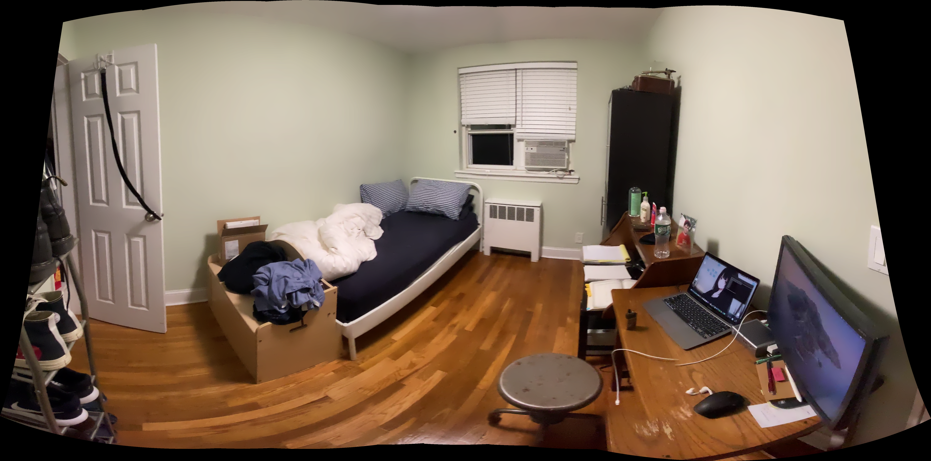
Results

Slide 9
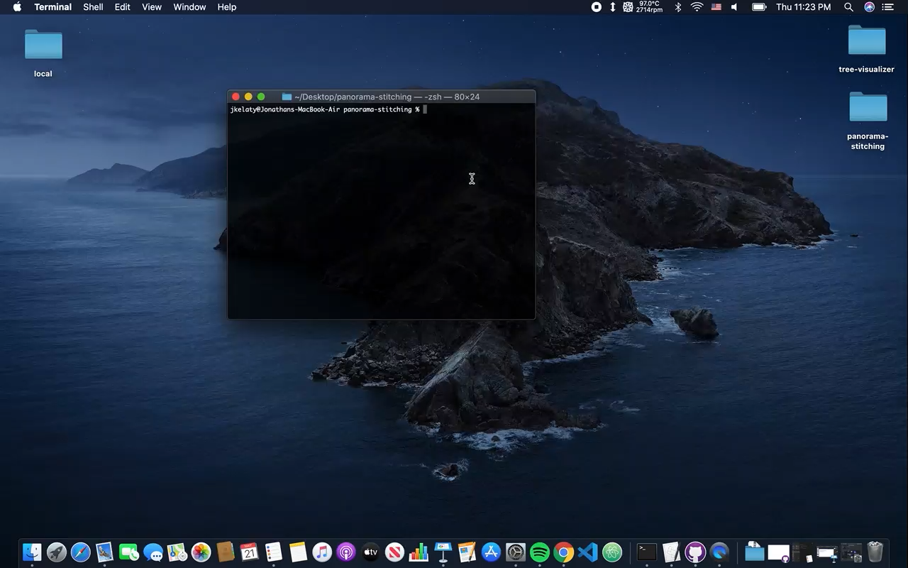
Video Demo (webcam interface)

